Slide 1
K-means Clustering
Ke Chen

Slide 2
Outline
Introduction
K-means Algorithm
Example
How K-means partitions?
K-means Demo
Relevant Issues
Application: Cell Neulei Detection
Summary

Slide 3
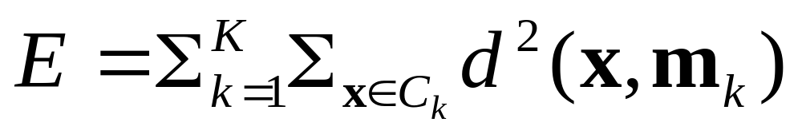
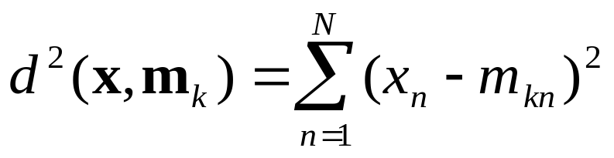
Introduction
Partitioning Clustering Approach
  a typical clustering analysis approach via iteratively partitioning training data set to learn a partition of the given data space
  learning a partition on a data set to produce several non-empty clusters (usually, the number of clusters given in advance)
  in principle, optimal partition achieved via minimising the sum of squared distance to its “representative object” in each cluster
e.g., Euclidean distance

Slide 4
Introduction
Given a K, find a partition of K clusters to optimise the chosen partitioning criterion (cost function)
  global optimum: exhaustively search all partitions
The K-means algorithm: a heuristic method
  K-means algorithm (MacQueen’67): each cluster is represented by the centre of the cluster and the algorithm converges to stable centriods of clusters.
  K-means algorithm is the simplest partitioning method for clustering analysis and widely used in data mining applications.

Slide 5
K-means Algorithm
Given the cluster number K, the K-means algorithm is carried out in three steps after initialisation:
Initialisation: set seed points (randomly)
Assign each object to the cluster of the nearest seed point measured with a specific distance metric
Compute new seed points as the centroids of the clusters of the current partition (the centroid is the centre, i.e., mean point, of the cluster)
Go back to Step 1), stop when no more new assignment (i.e., membership in each cluster no longer changes)

Slide 6
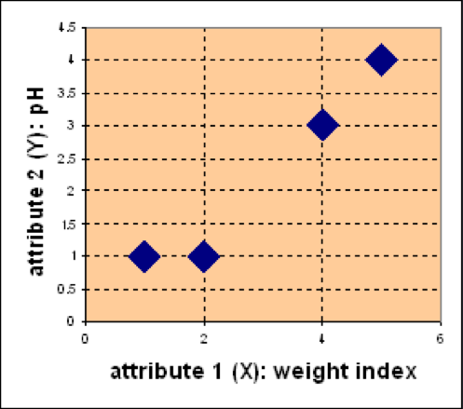
Example
Problem
Suppose we have 4 types of medicines and each has two attributes (pH and
weight index). Our goal is to group these objects into K=2 group of medicine.
D
Medicine | Weight | pH-Index
A | 1 | 1
B | 2 | 1
C | 4 | 3
D | 5 | 4
C
A
B

Slide 7
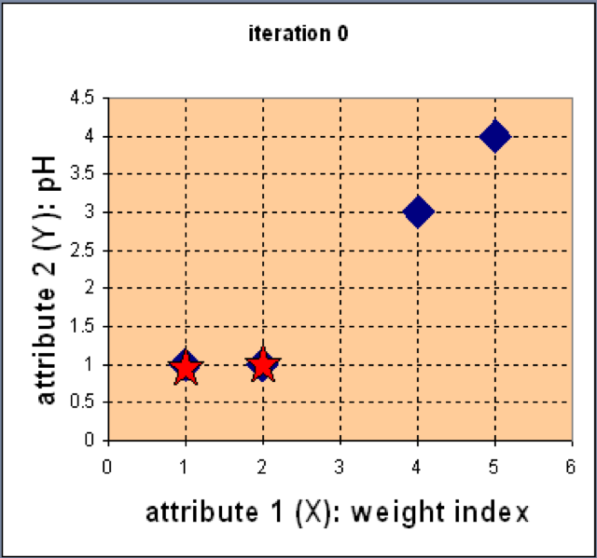

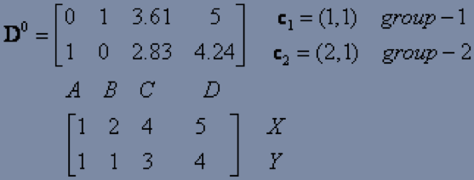
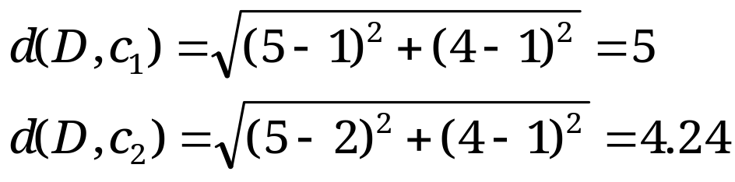
Example
Step 1: Use initial seed points for partitioning
D
C
Euclidean distance
A
B
Assign each object to the cluster
with the nearest seed point

Slide 8
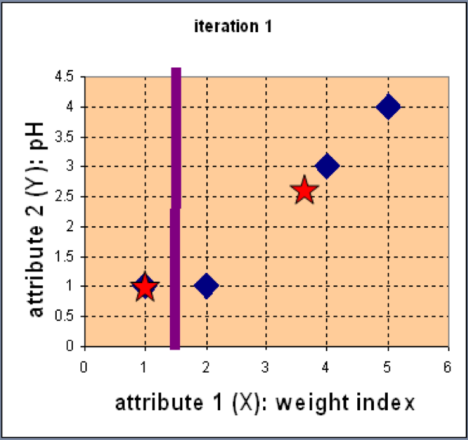
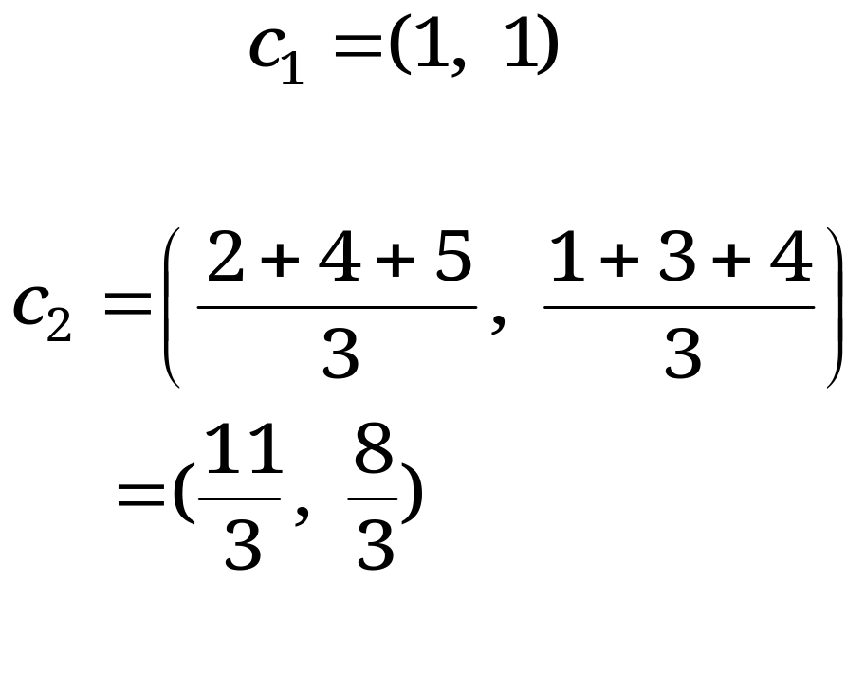
Example
Step 2: Compute new centroids of the current partition
Knowing the members of each
cluster, now we compute the new
centroid of each group based on
these new memberships.

Slide 9
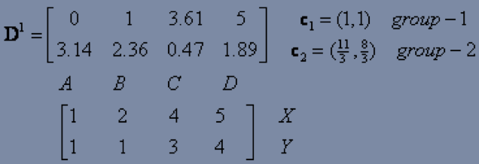
Example
Step 2: Renew membership based on new centroids
Compute the distance of all objects to the new centroids
Assign the membership to objects

Slide 10
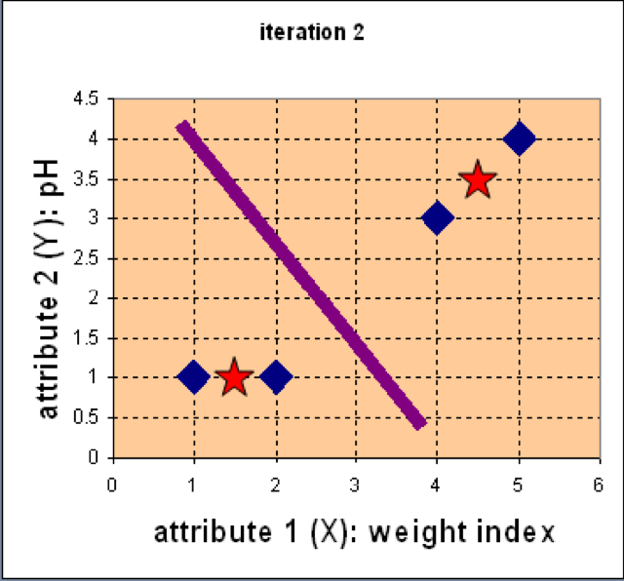
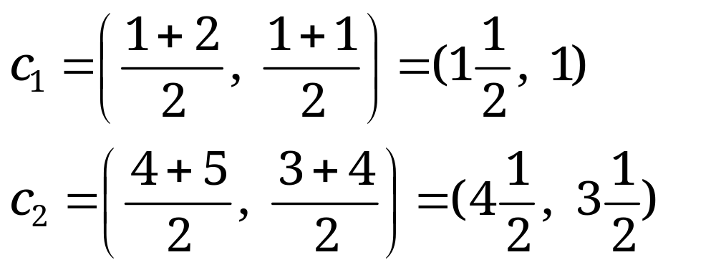
Example
Step 3: Repeat the first two steps until its convergence
Knowing the members of each
cluster, now we compute the new
centroid of each group based on
these new memberships.

Slide 11
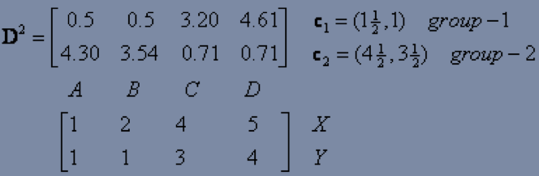
Example
Step 3: Repeat the first two steps until its convergence
Compute the distance of all objects to the new centroids
Stop due to no new assignment
Membership in each cluster no longer change

Slide 12
Exercise
For the medicine data set, use K-means with the Manhattan distance
metric for clustering analysis by setting K=2 and initialising seeds as
C1 = A and C2 = C. Answer three questions as follows:
How many steps are required for convergence?
What are memberships of two clusters after convergence?
What are centroids of two clusters after convergence?
Medicine | Weight | pH-Index
A | 1 | 1
B | 2 | 1
C | 4 | 3
D | 5 | 4
D
C
A
B

Slide 13
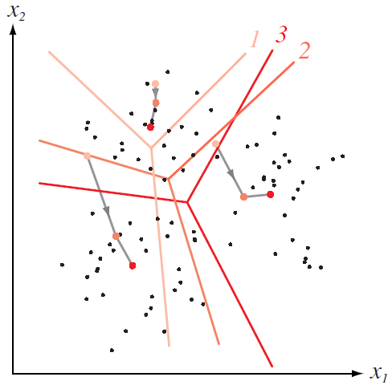
How K-means partitions?
When K centroids are set/fixed,
they partition the whole data space into K mutually exclusive subspaces to form a partition.
A partition amounts to a
Changing positions of centroids leads to a new partitioning.
Voronoi Diagram

Slide 14
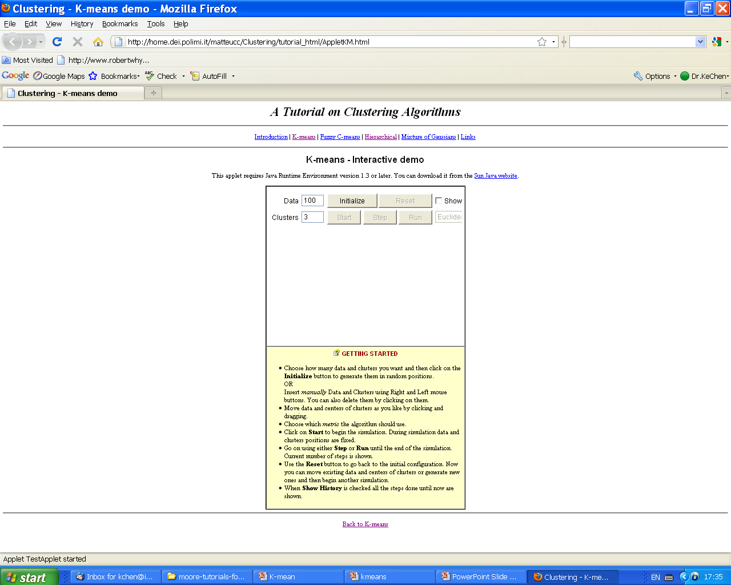
K-means Demo
K-means Demo

Slide 15
Relevant Issues
Efficient in computation
  O(tKn), where n is number of objects, K is number of clusters, and t is number of iterations. Normally, K, t << n.
Local optimum
  sensitive to initial seed points
  converge to a local optimum: maybe an unwanted solution
Other problems
  Need to specify K, the number of clusters, in advance
  Unable to handle noisy data and outliers (K-Medoids algorithm)
  Not suitable for discovering clusters with non-convex shapes
  Applicable only when mean is defined, then what about categorical data? (K-mode algorithm)
  how to evaluate the K-mean performance?

Slide 16
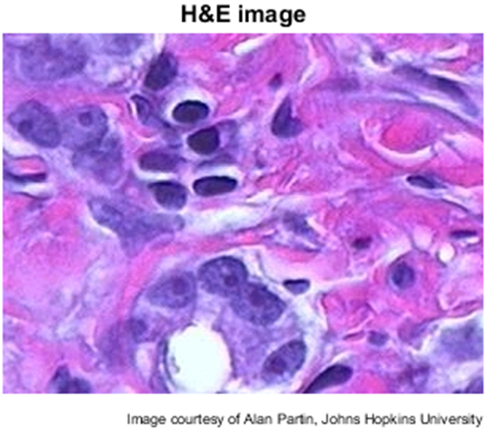
Application
Colour-Based Image Segmentation Using K-means
  Step 1: Loading a colour image of tissue stained with hemotoxylin and eosin (H&E)
Notes:
RGB: (x, y) with (r,g,b)

Slide 17
Application
Colour-Based Image Segmentation Using K-means
  Step 2: Convert the image from RGB colour space to L*a*b* colour space
      Unlike the RGB colour model, L*a*b* colour is designed to approximate human vision.
      There is a complicated transformation between RGB and L*a*b*.
      (L*, a*, b*) = T(R, G, B).
      (R, G, B) = T’(L*, a*, b*).
Notes:
RGB: pixel (x, y) with (r,g,b)
L for lightness and a and b for the color-opponent dimensions, based on nonlinearly compressed (e.g. CIE XYZ color space) coordinates

Slide 18
Application
Colour-Based Image Segmentation Using K-means
  Step 3: Undertake clustering analysis in the (a*, b*) colour space with the K-means algorithm
      In the L*a*b* colour space, each pixel has a properties or feature vector: (L*, a*, b*).
      Like feature selection, L* feature is discarded. As a result, each pixel has a feature vector (a*, b*).
      Applying the K-means algorithm to the image in the a*b* feature space where K = 3 (by applying the domain knowledge.
Notes:
RGB: (x, y) with (r,g,b)

Slide 19
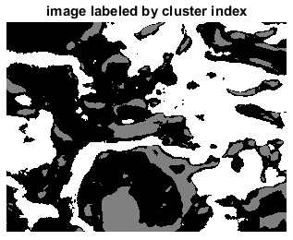
Application
Colour-Based Image Segmentation Using K-means
  Step 4: Label every pixel in the image using the results from
  K-means Clustering (indicated by three different grey levels)
Notes:
RGB: (x, y) with (r,g,b)

Slide 20
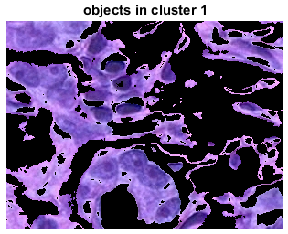
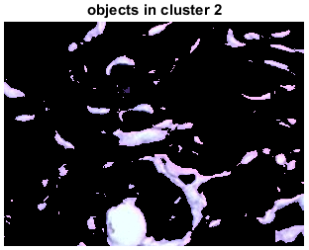
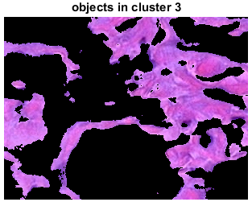
Application
Colour-Based Image Segmentation Using K-means
  Step 5: Create Images that Segment the H&E Image by Colour
      Apply the label and the colour information of each pixel to achieve separate colour images corresponding to three clusters.
Notes:
RGB: (x, y) with (r,g,b)

Slide 21
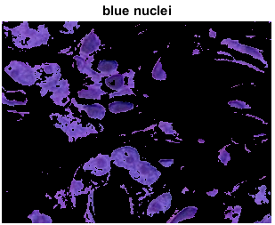
Application
Colour-Based Image Segmentation Using K-means
  Step 6: Segment the nuclei into a separate image with the L* feature
In cluster 1, there are dark and light blue objects. The dark blue objects correspond to nuclei (with the domain knowledge).
L* feature specifies the brightness values of each colour.
With a threshold for L*, we achieve an image containing the nuclei only.
Notes:
RGB: (x, y) with (r,g,b)

Slide 22
Summary
K-means algorithm is a simple yet popular method for clustering analysis
Its performance is determined by initialisation and appropriate distance measure
There are several variants of K-means to overcome its weaknesses
  K-Medoids: resistance to noise and/or outliers
  K-Modes: extension to categorical data clustering analysis
  CLARA: extension to deal with large data sets
  Mixture models (EM algorithm): handling uncertainty of clusters
Online tutorial: the K-means function in Matlab
https://www.youtube.com/watch?v=aYzjenNNOcc

